Slide 1
Augmenting 1 dimensional data

Slide 2
Problem
We have responses that are in low abundance. These are the 10mM pulses. When a feature is in low abundance, the network will not understand this type of response very well. Due to this problem, we need to implement a way to bolster our data to include more of this type of response. But we cannot simply duplicate these data. Instead what we need to do is to create synthetic responses to the dataset to see if it improves scoring.

Slide 3
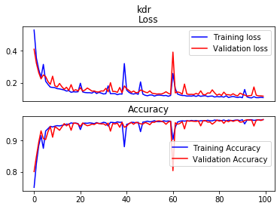
Without augmented data we are seeing fairly good training. Although noisy there are no signs of overfitting.

Slide 4
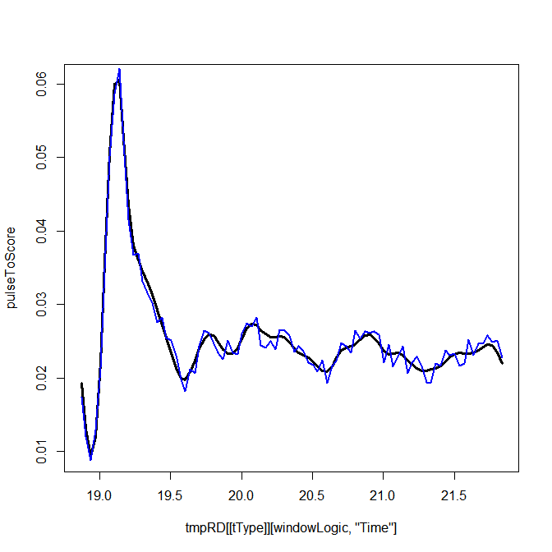
The method I am invokingis to add noise to the original traces ~ 50 to 60 times. To bolster the training data.

Slide 5
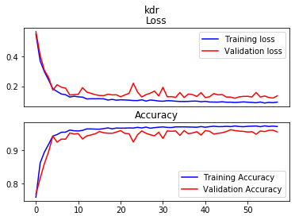
Once we include augmented data overfitting becomes apparent, and success does not improve at all.

Slide 6
What I need is a better way to create responses mimicking rare responses.

Slide 7

Another problem is that lukes data has inconsistent image capture below represents the number of time points per each 4 minute interval

Slide 8
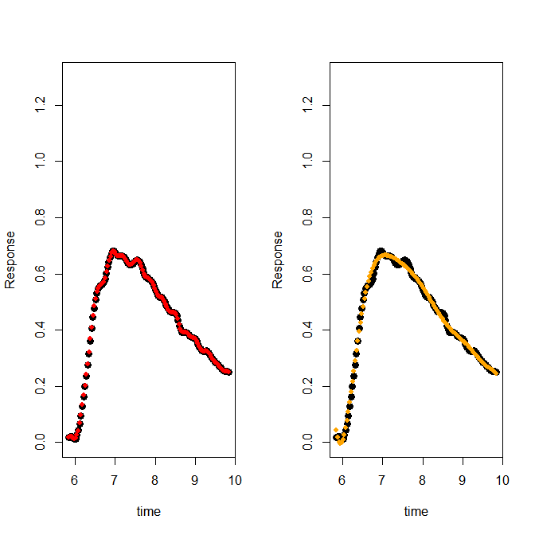

Slide 9
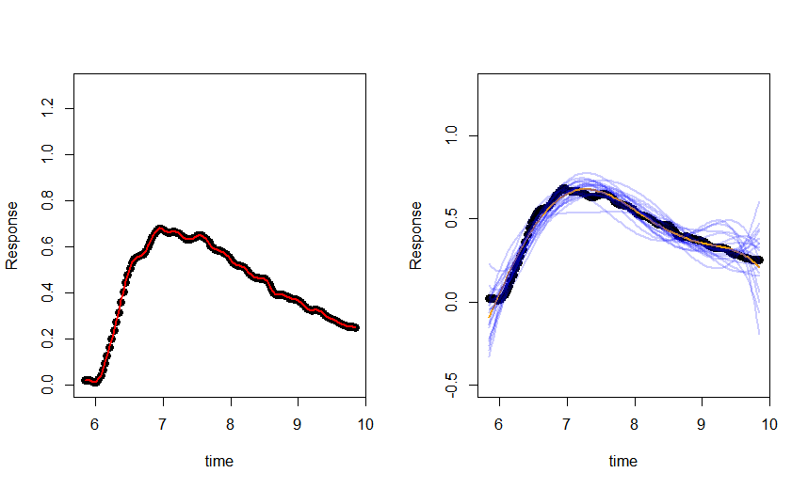

Slide 10
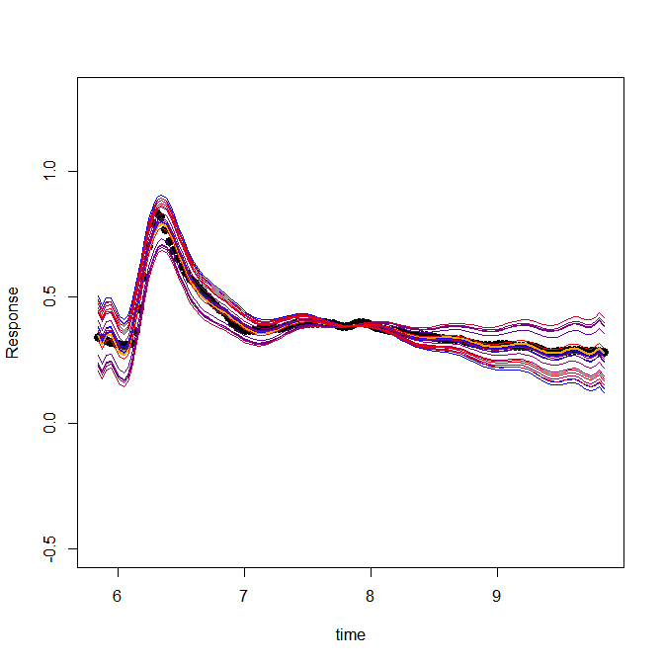
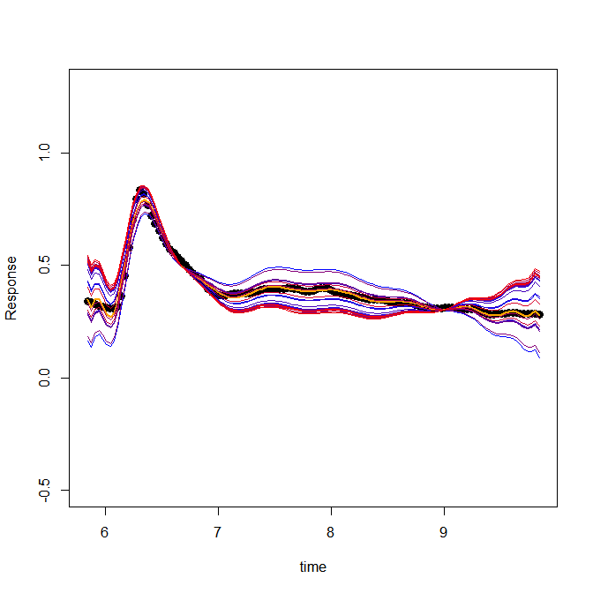
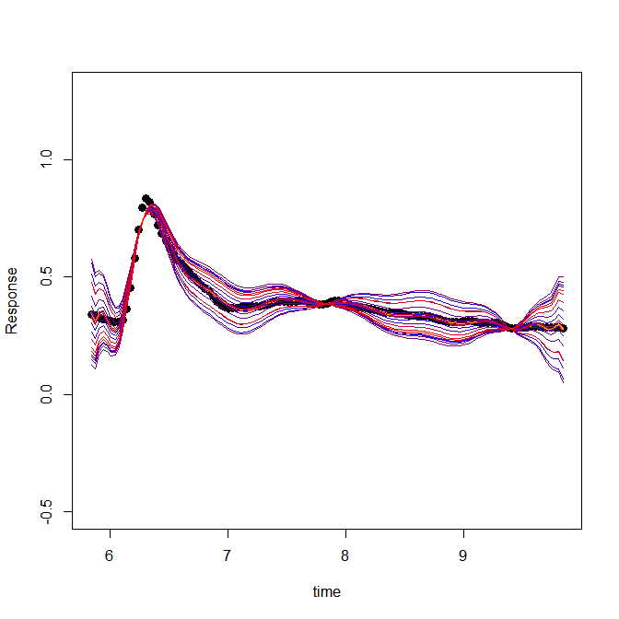
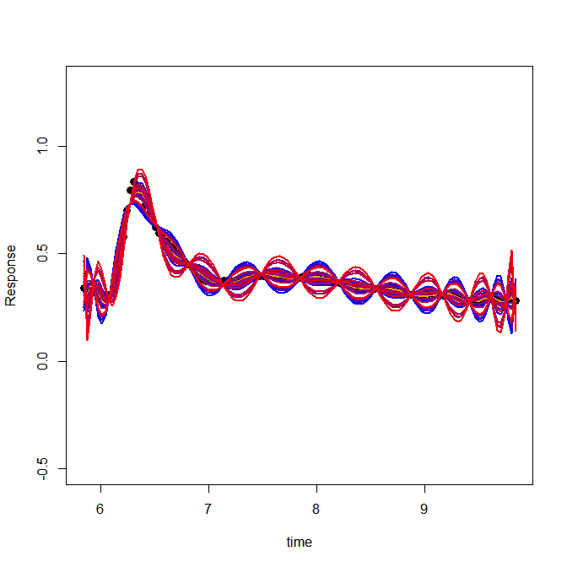
Using a high degree polynomial function (17), we can map a function to the responses. From there we can randomize the coefficients to obtain different fits. Altering the higher order polynomials results in very strange behavior
Coefficients
2
3
4
15

Slide 11
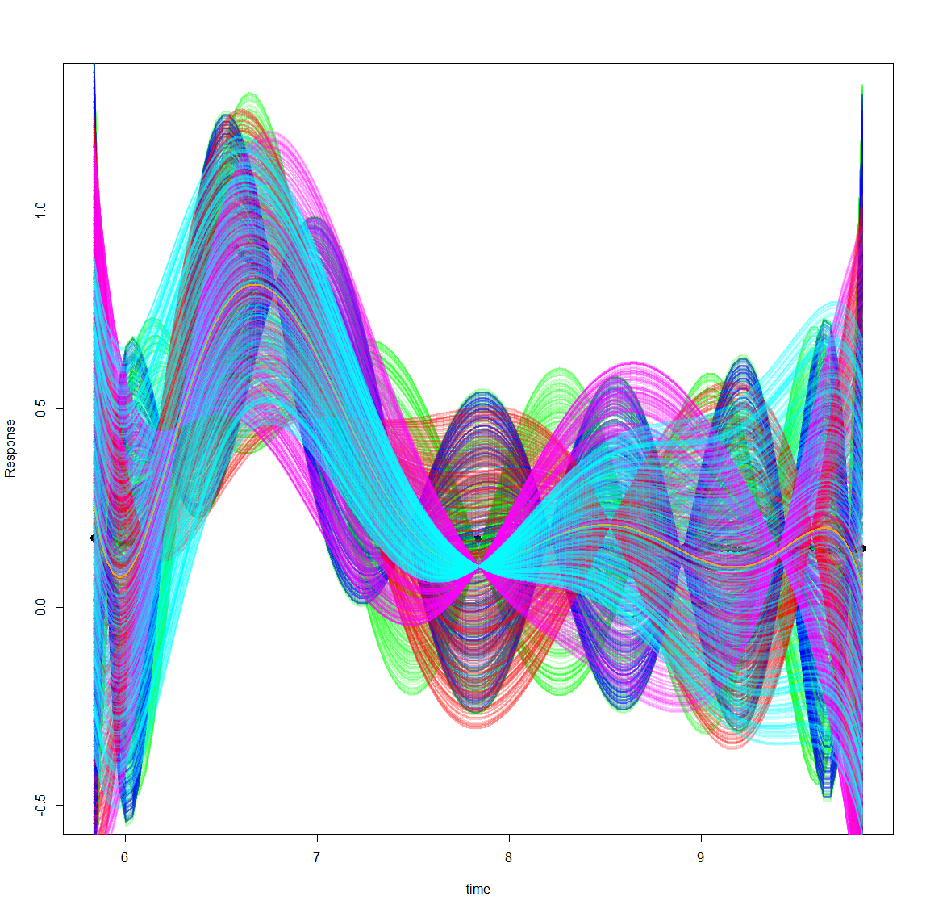

Slide 12
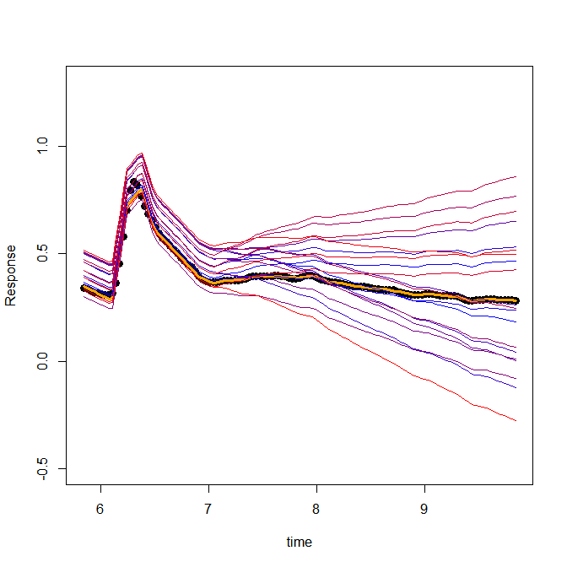
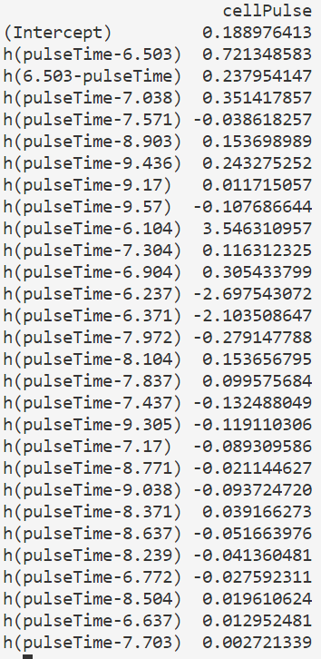
I can use a MARs model to create synthetic responses. Now I’m attempting to randomize the coefficients, but I can’t randomize by the same amount. Instead what I need to accomplish is a randomization within the range the values each coefficient occupies.. I need a clever way to do this

Slide 13
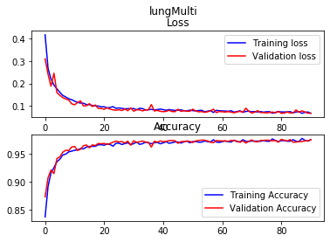
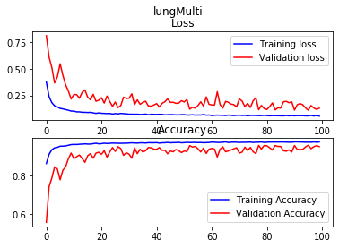
Lungmultimodels: This is a general purpose model trained on the lung cancer data.
Balanced validation set
The results of the Neural network is
Ones: 7.409692 %
Zeros: 1.910701 %
The results of the Neural network is
Ones: 7.69758 %
Zeros: 1.649526 %

Slide 14
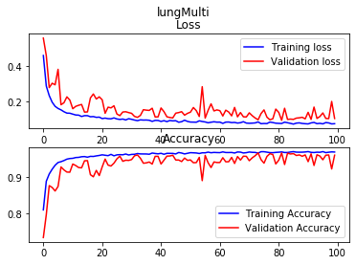
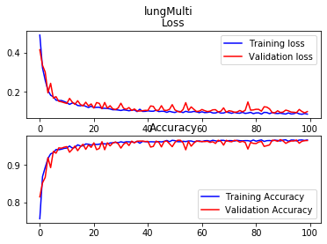
Balanced validation set
Oversampled 1’s
Balanced validation set
Oversampled 1’s
Undersampled 0’s
The results of the Neural network is
Ones: 5.195695 %
Zeros: 2.420554 %
The results of the Neural network is
Ones: 4.078415 %
Zeros: 2.721718 %

Slide 16
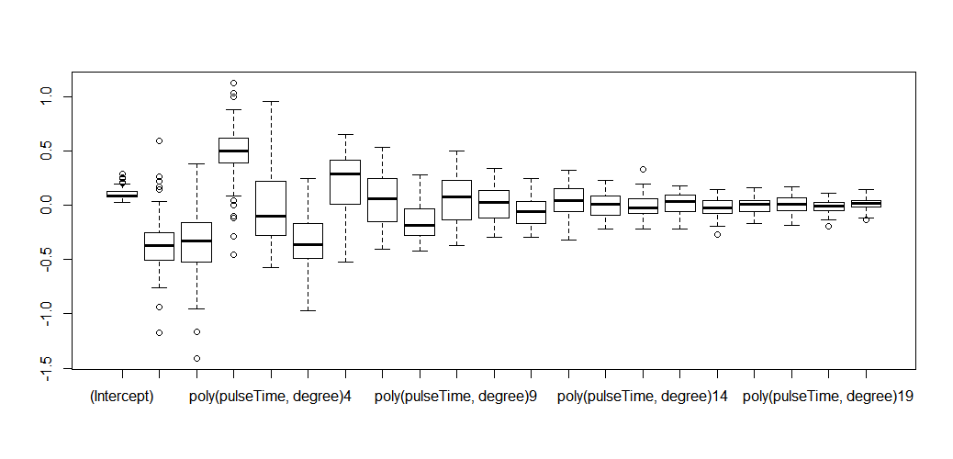
Augmentin with polynomial fits When I perform the fit on many different samples and collect the coefficients, I can gain a better understanding of what ranges to augment the data

Slide 17
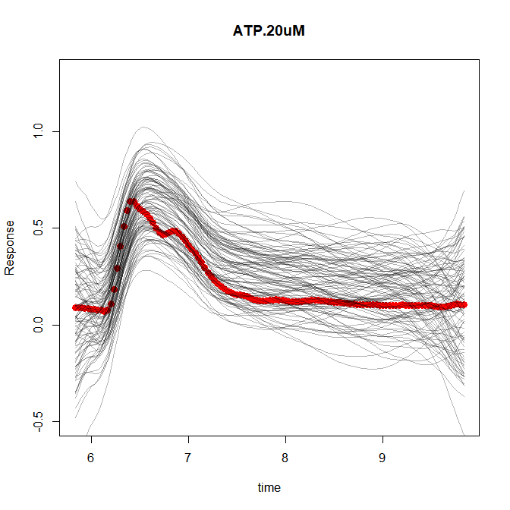

Slide 18
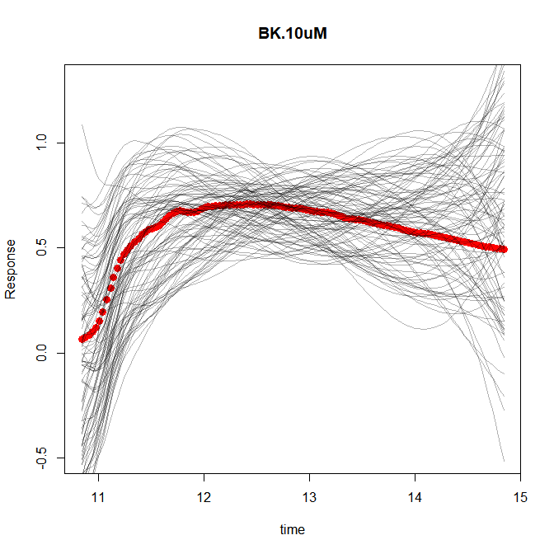

Slide 19
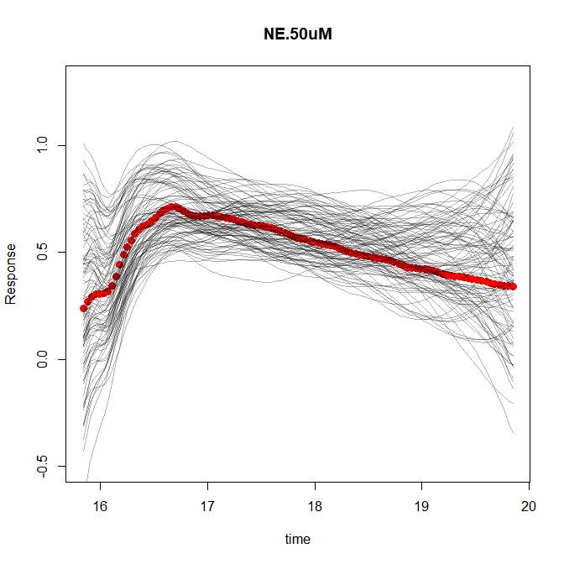

Slide 20
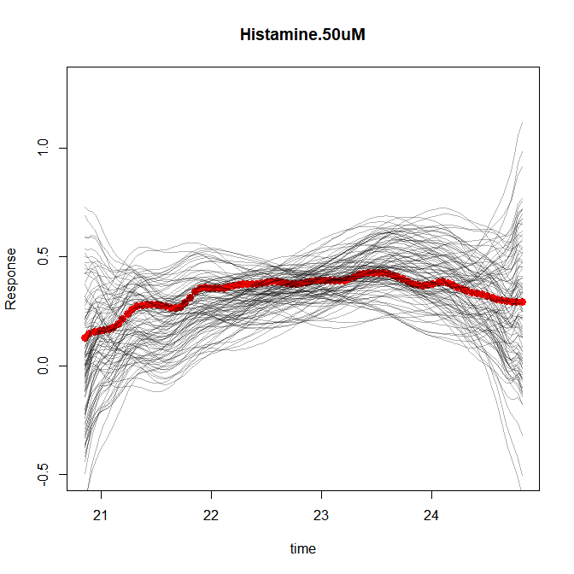

Slide 22
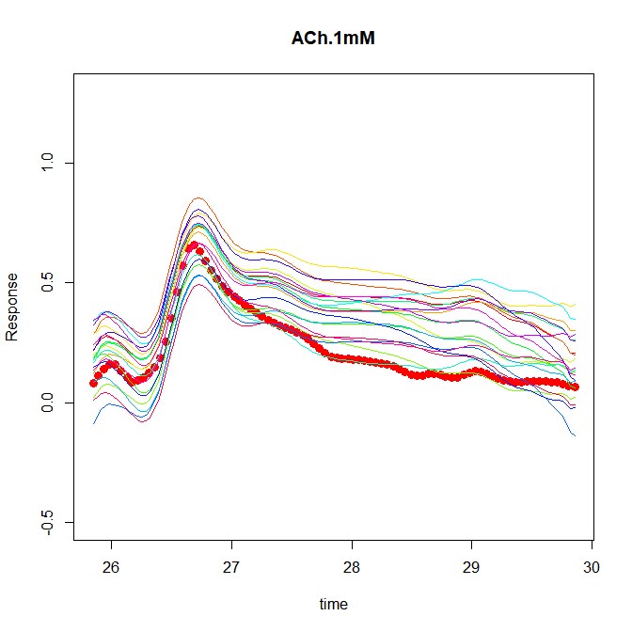
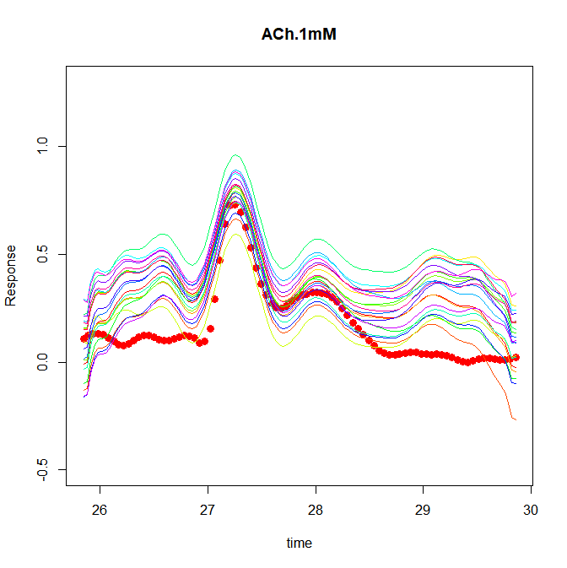

Slide 23
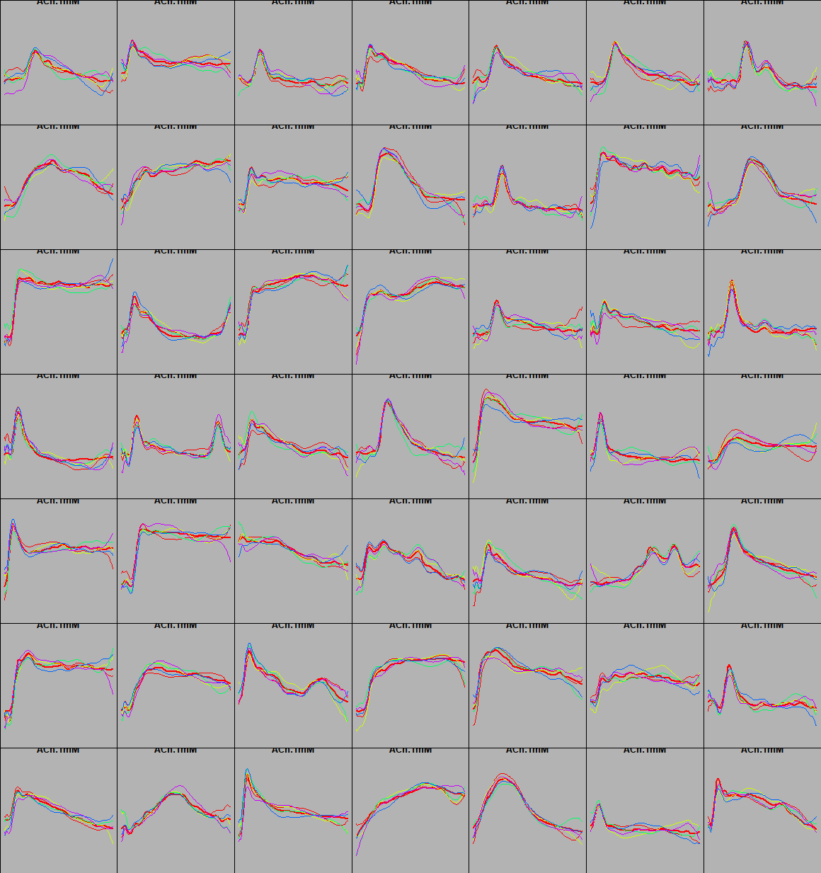
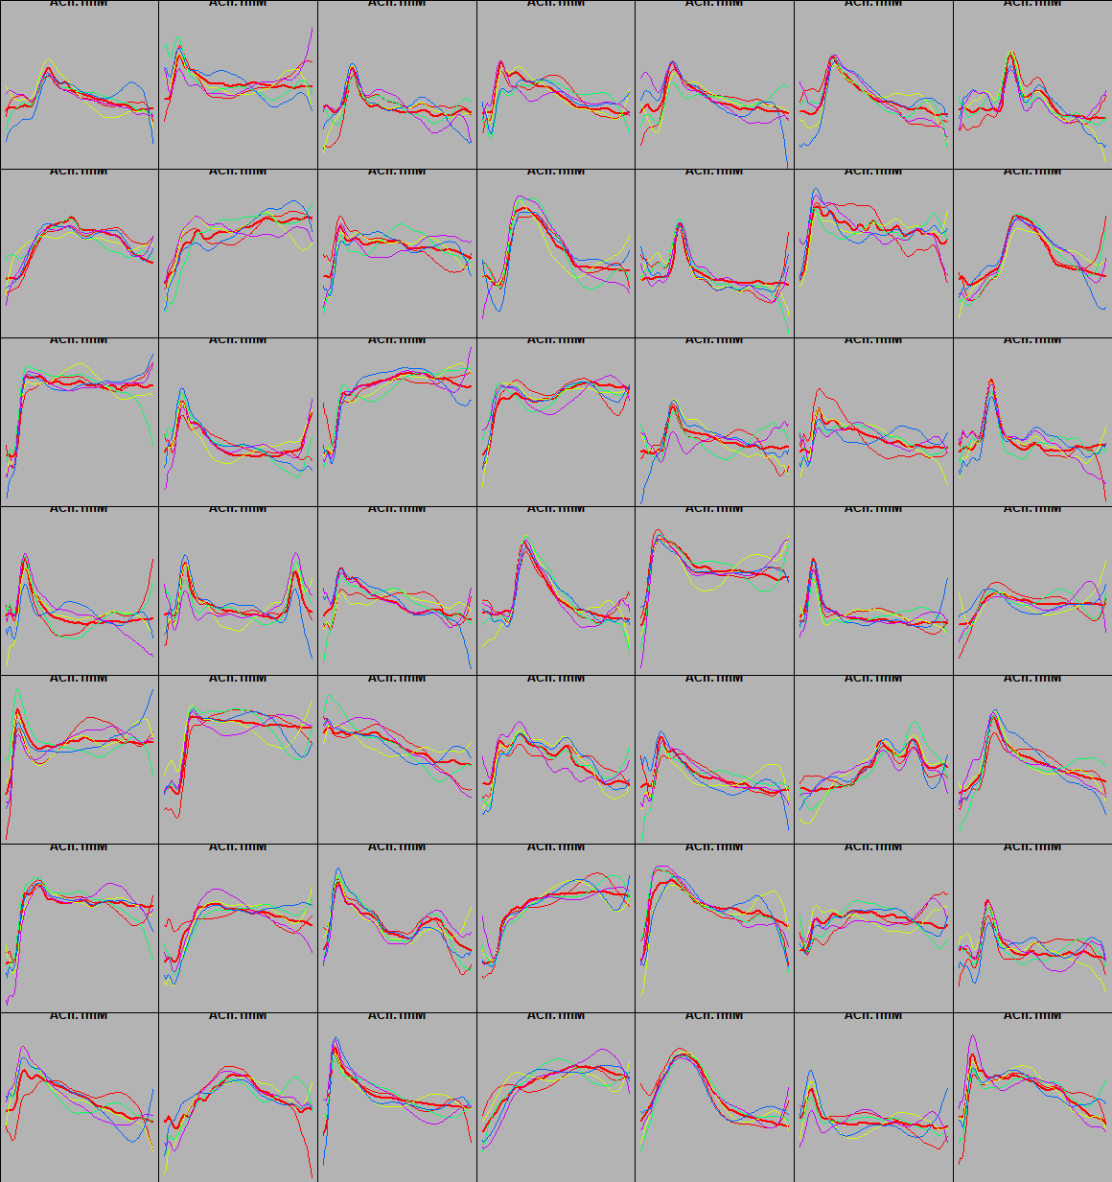
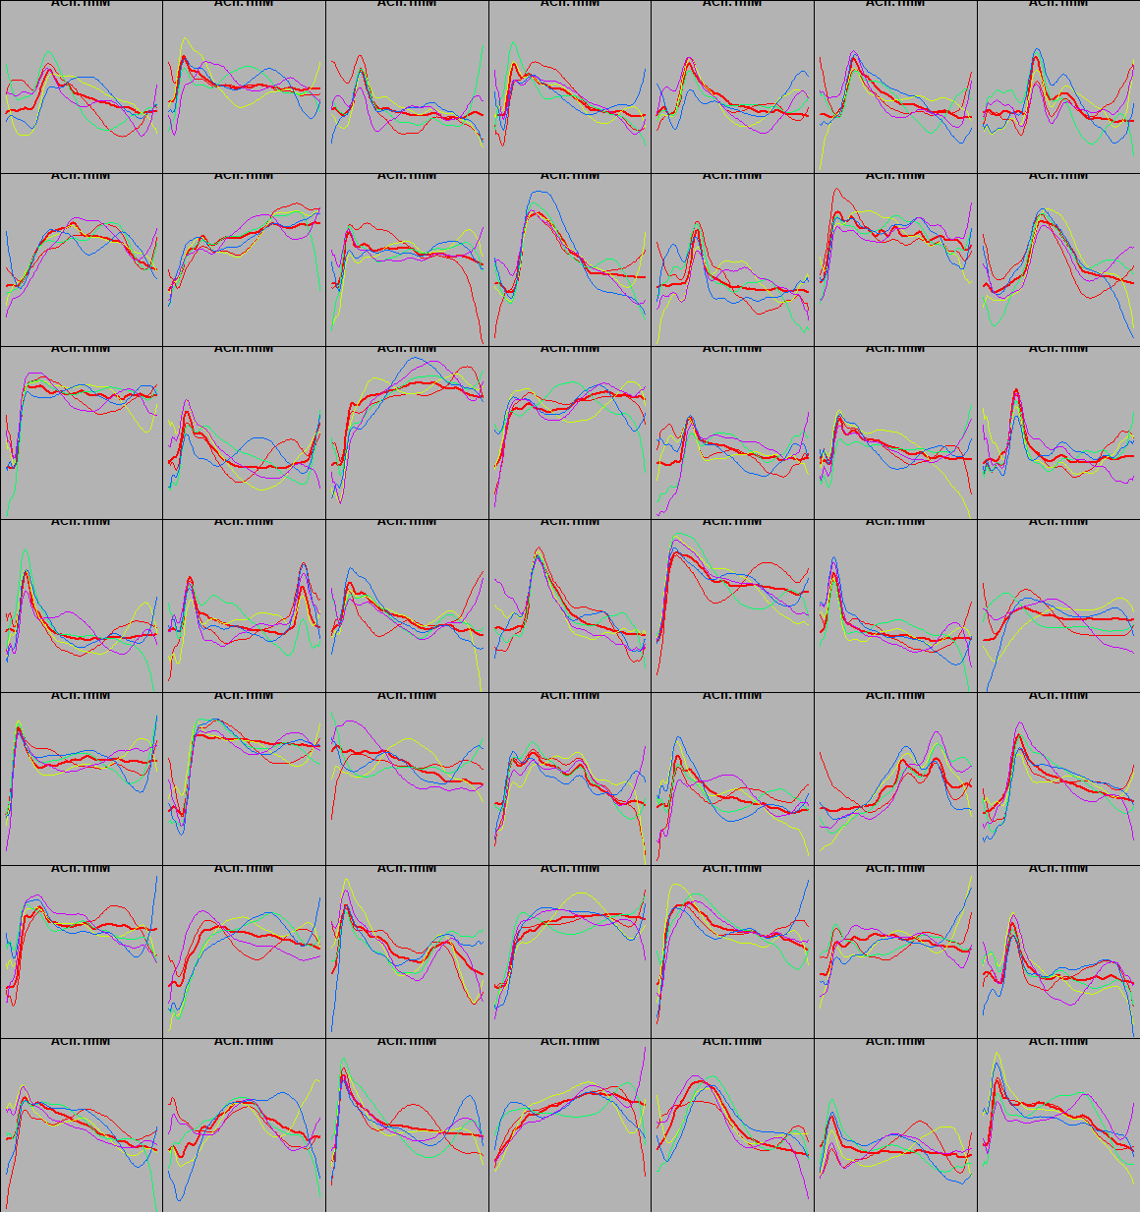
Developing Synthetic responses. The general workflow here is to
Determine the spread of coefficients in my 20 order polynomial. Now that I have this spread
For each cell fit the trace to a polynomical 20 order.
Generate sample traces where the polynomical values are altered around the current coefficients value + a standard deviation * stdmultiplication value.
Below shows the different polynomials std multiplication values ontop of the original trace.
1
1.6
2

Slide 24
